Slide 1
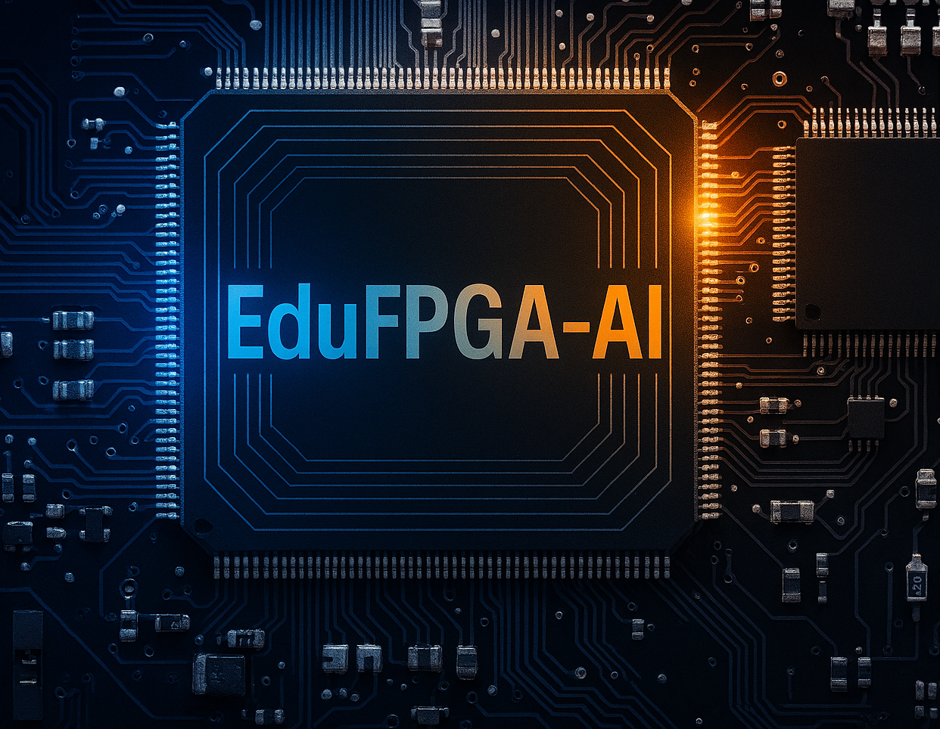
Educational Platforms &Frameworks for Learning AI on FPGA Hardware
Mohamed Abdo
Hamm-Lippstadt University of Applied Sciences
Prof. Dr. –Ing. Ali Hayek
[08.12.2026]

Slide 2
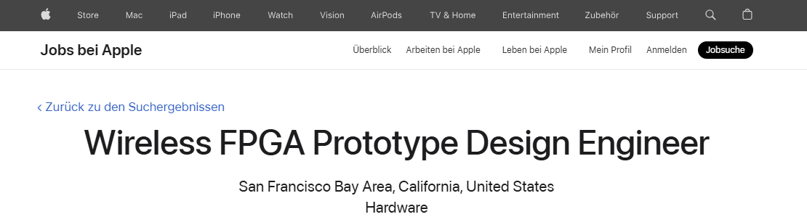

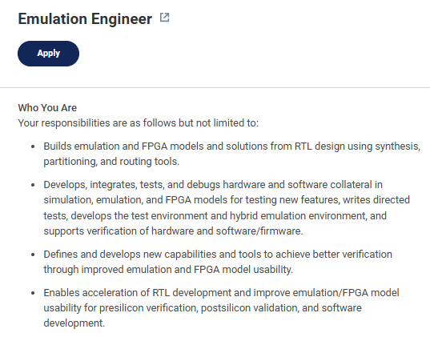

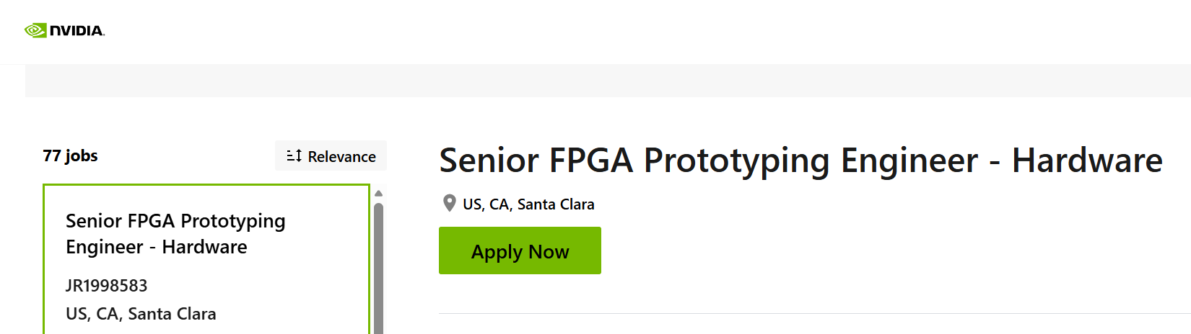

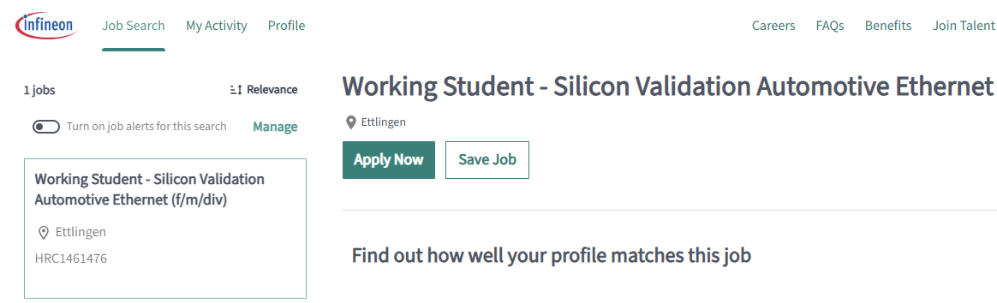

Motivation
Skills Acquired?

Slide 3
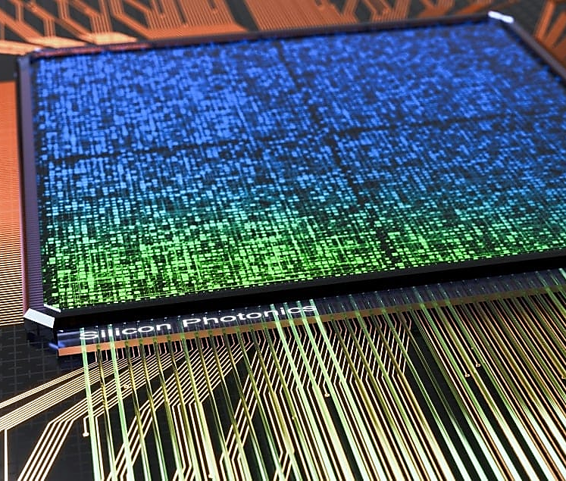
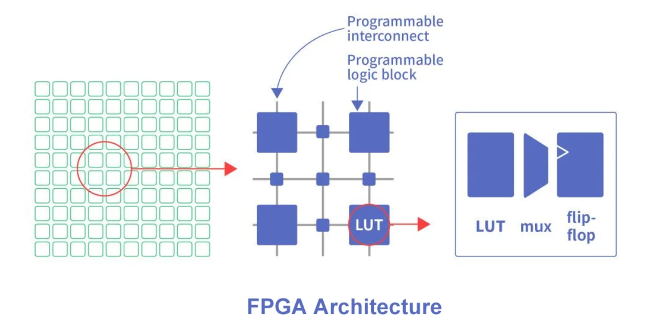
What is FPGA-AI?
1- Standalone FPGAs:
Programmable Logic Blocks
Thousands/millions of identical units
Basic digital components: LUTs, flip-flops, gates
Building blocks for any digital circuit without new silicon
Programmable Interconnects
Re-routable wiring network
Connects logic blocks in any configuration
Enables custom circuit pathways
Hardened Components (Modern FPGAs)
Fixed-function blocks for efficiency:
DSP slices: Optimized math operations
Block RAM (BRAM): High-speed memory
AI Engines: Dedicated neural network hardware (AMD Versal)
Unlike:
CPU: Fixed hardware architecture, programmed with software
GPU: Massively parallel, but still fixed-architecture processor
FPGA fully reconfigurable

Slide 4
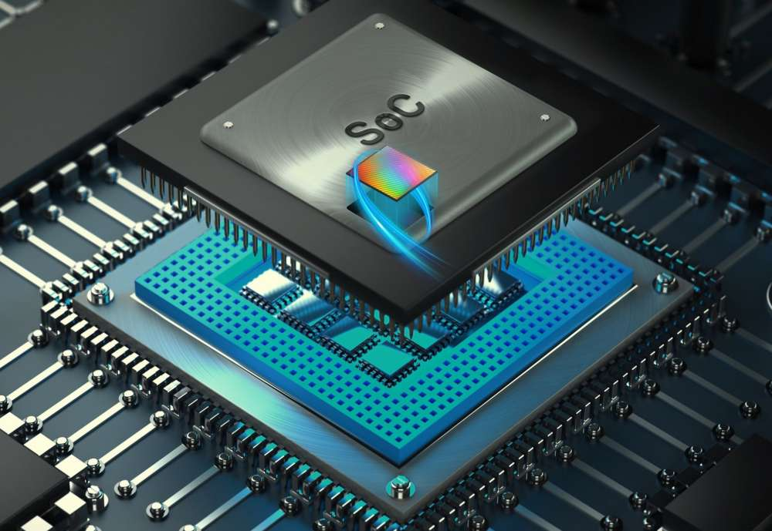

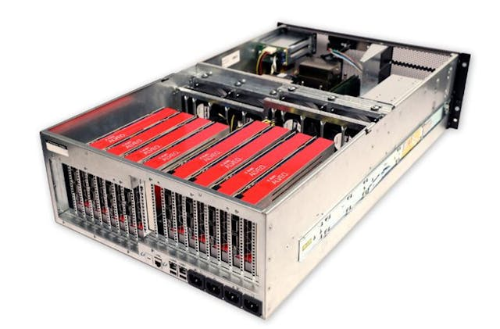
What is FPGA-AI?
2- SoC FPGA
Hybrid Architecture: ARM processors + FPGA fabric on single chip
Power Efficiency: FPGA activates only needed logic
Split Processing: CPU handles software, handles acceleration
Zynq UltraScale+ MPSoC
3- High-End FPGA: Data Center Acceleration(Alveo)
Huge FPGAs: Largest capacity available
High-Bandwidth Memory (HBM): (16-32GB) with 460+ GB/s bandwidth, ultra-fast access

Slide 5
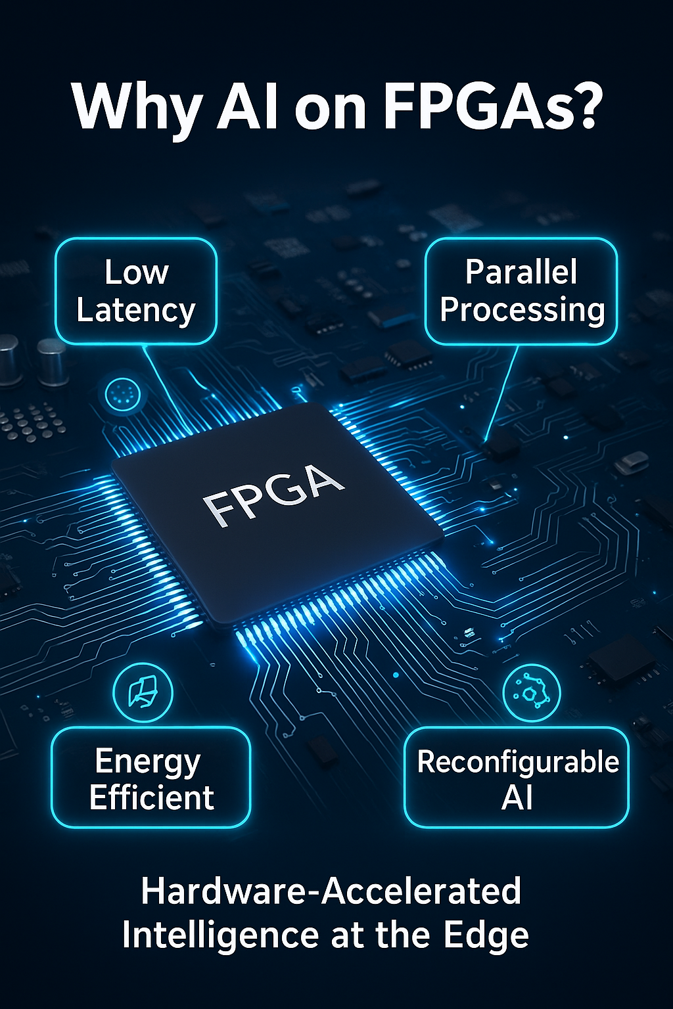
Flexibility & Reconfigurability
Update hardware architecture as AI models evolve
Ideal for rapidly changing algorithms
Deploy different models to same hardware at different times
Parallelism:
Design circuits with hundreds/thousands of parallel elements
All elements work simultaneously on different data parts
Handles architectures difficult for CPUs/GPUs to parallelize
Memory-augmented neural networks (MANNs), which in clude memory networks which is difficult to parallelize on CPUs or GPUs. [2]
Low Latency:
Data flows directly through custom circuits
Minimal processing overhead. [2]
Crucial for real-time applications (medical, predictions)
Power Efficiency:
Custom circuits perform exact operations needed
No wasted energy on fetching/decoding generic instructions
And Deep neural networks (DNNs) require more computing power and storage than most mobile devices can provide
Custom Datapaths:
Design exact bit-width needed (e.g., 8-bit for quantized models)
Avoid waste of generic 32-bit floating-point units in CPUs/GPUs.
Optimize for specific model requirements

Slide 6

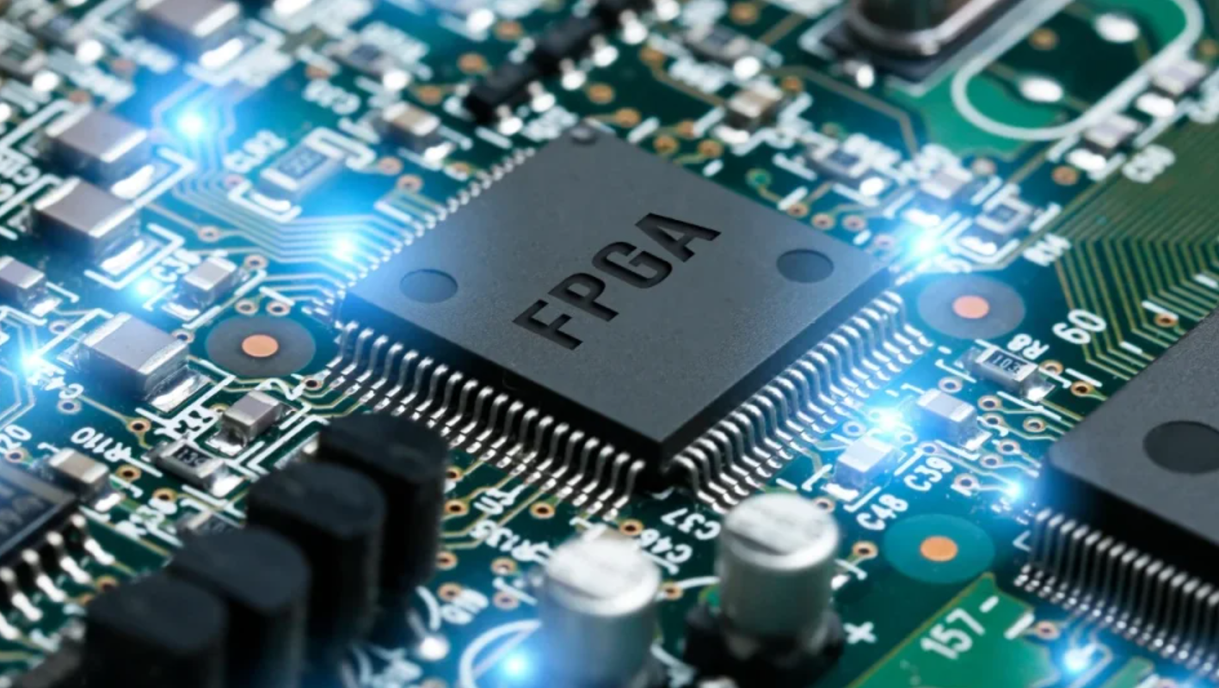

Slide 7
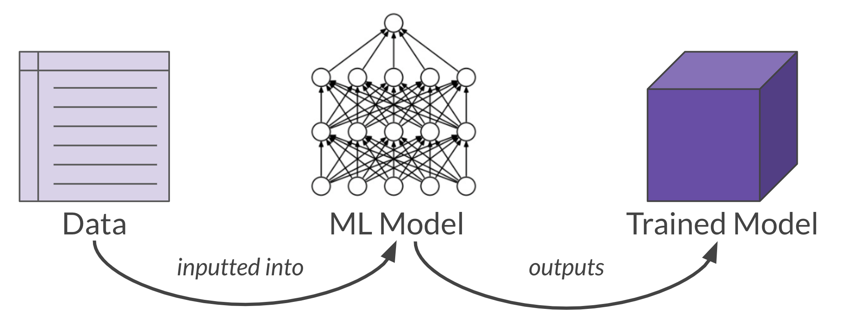
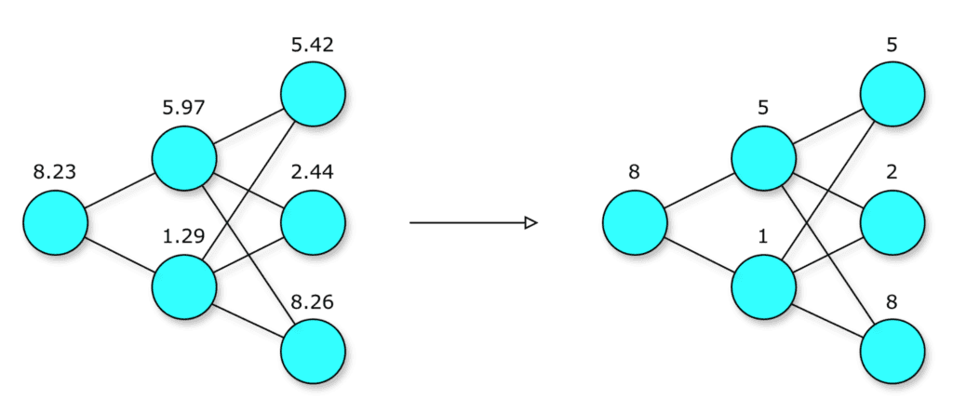
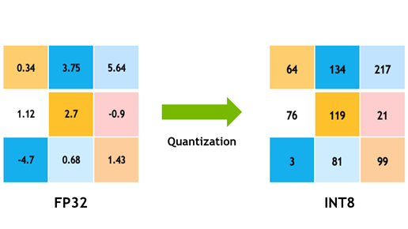
Quantization & Deployment FLOW
Quantization: Convert 32-bit floats → 8-bit integers
100 MB → 25 MB (75% reduction)
Result: ~4x smaller model, ~2-4x faster, minimal accuracy loss

Slide 8
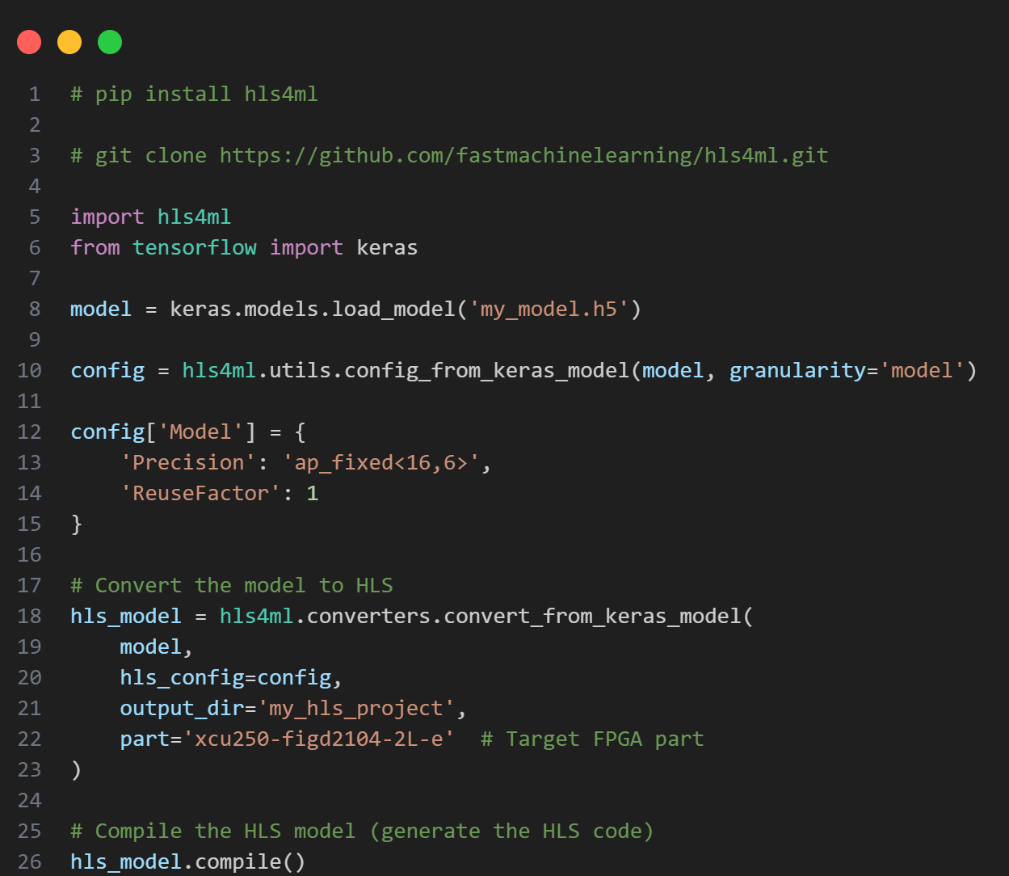
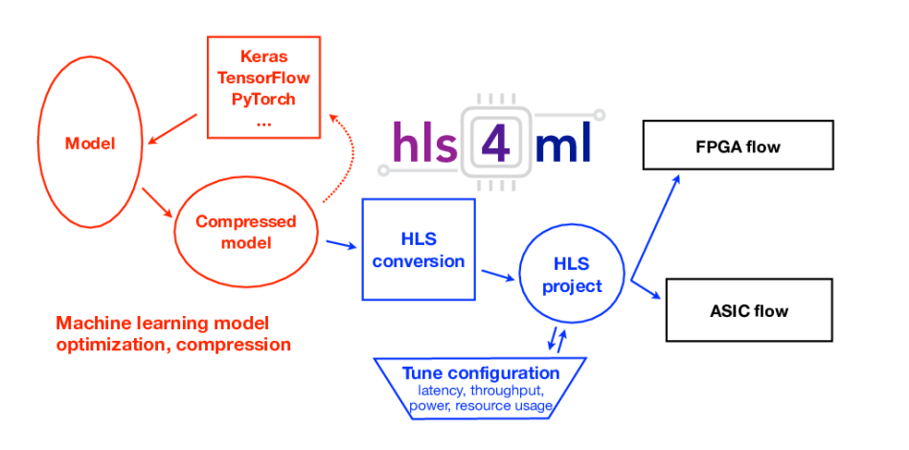
Hls4ml Framework
hls4ml (High-Level Synthesis for Machine Learning)
Open-source framework for converting ML models to FPGA firmware
Specializes in neural network deployment on FPGAs
Enables high-performance, low-latency FPGA inference
Used by researchers and engineers for efficient model deployment

Slide 9
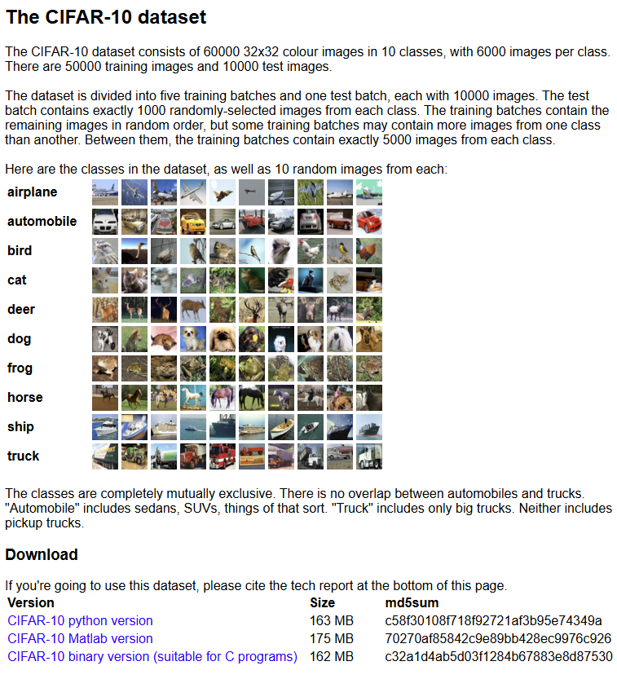
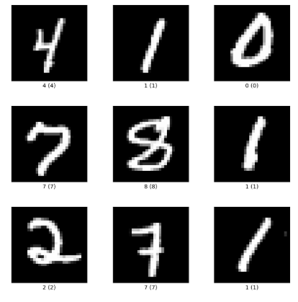
Datasets & AI projects:
CIFAR-10 and CIFAR-100 datasets
mnist | TensorFlow Datasets

Slide 10
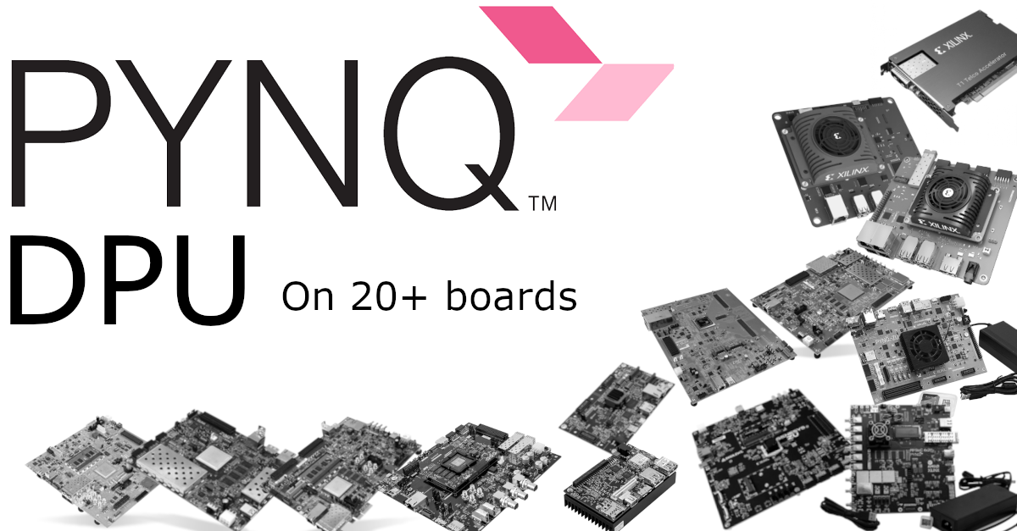
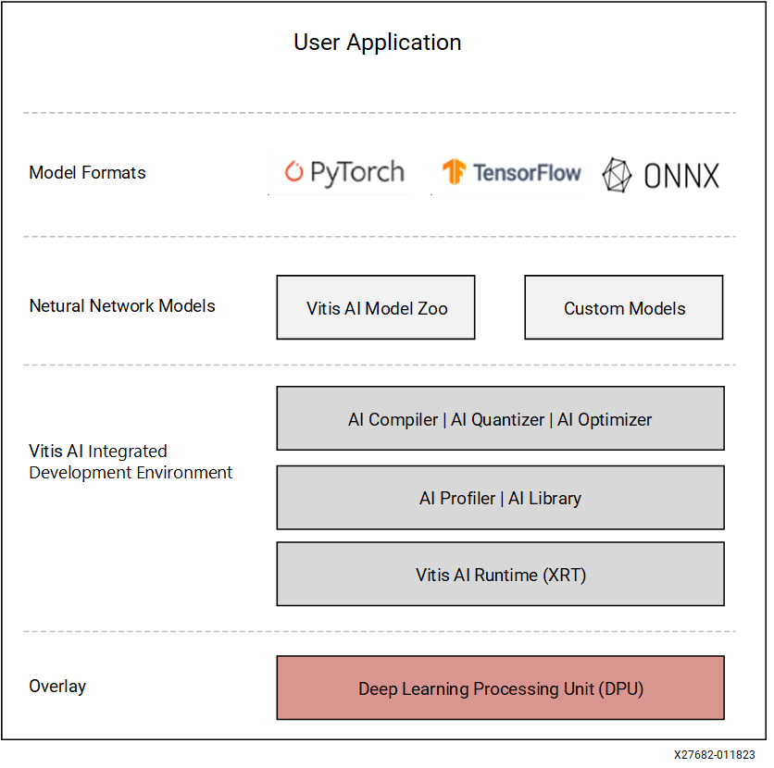
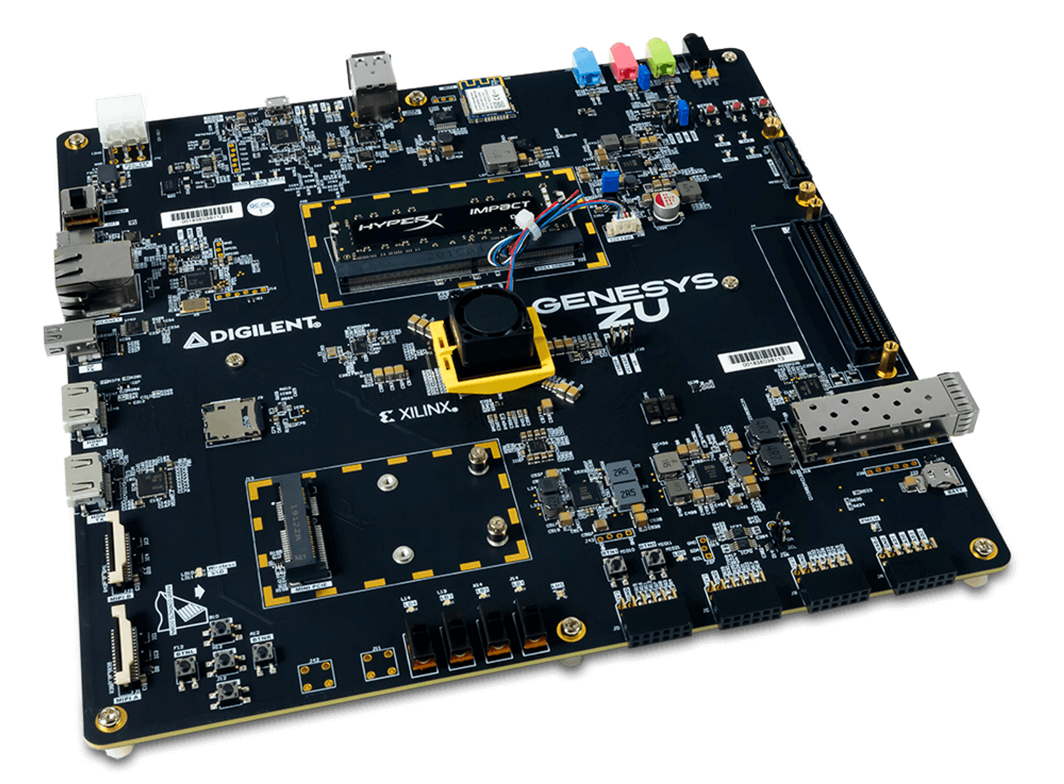
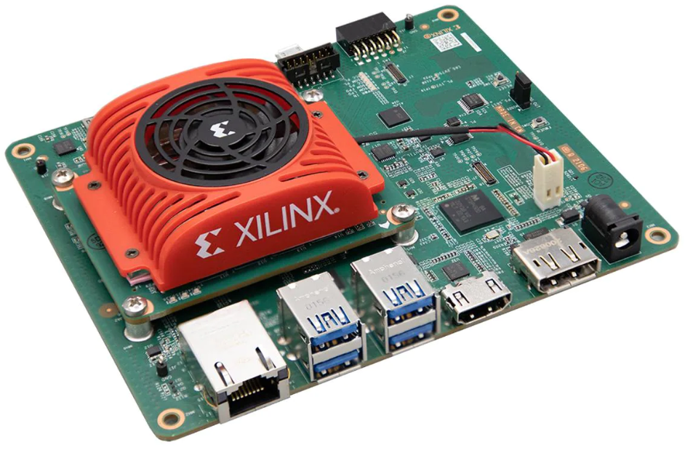
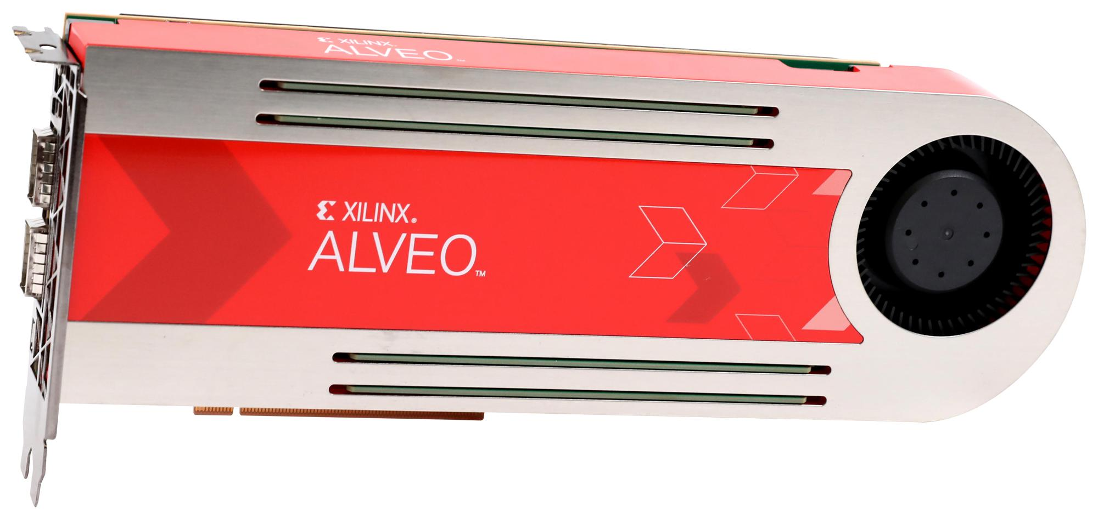
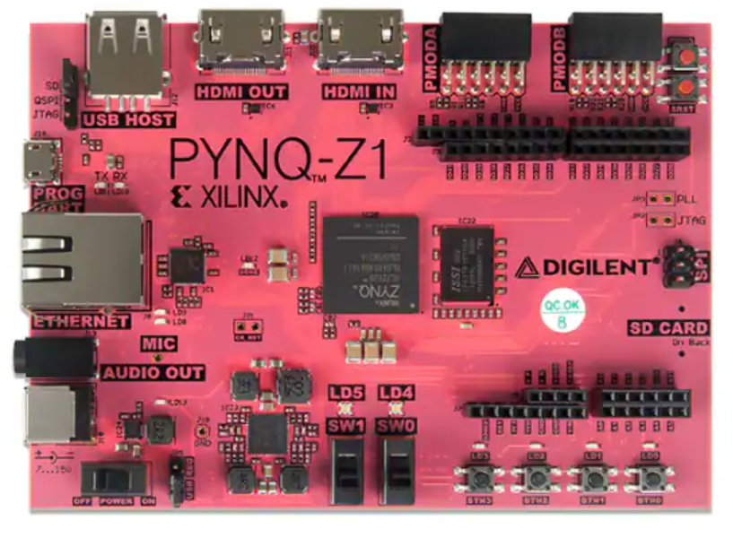
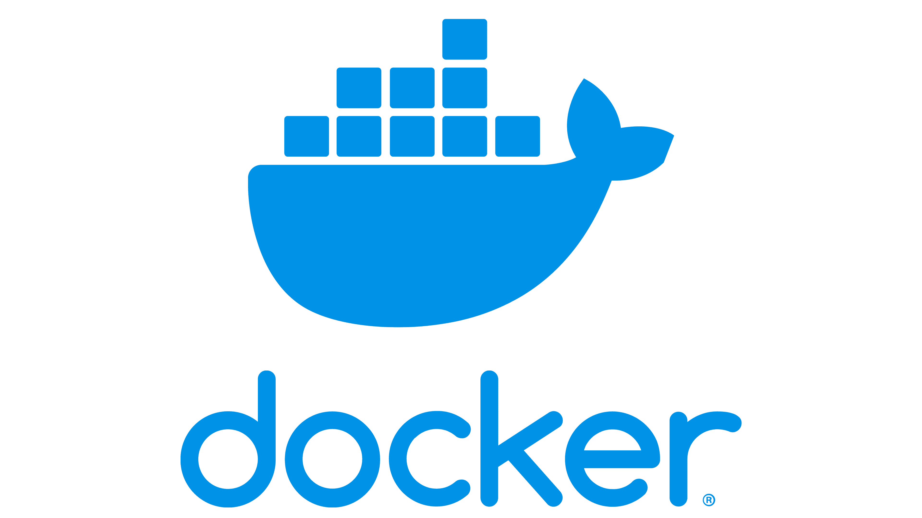

PYNQ framework
[4]
Zynq™
Zynq UltraScale+™
Kria™
Alveo™ accelerator boards

Slide 11
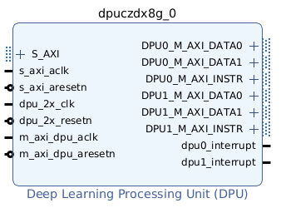
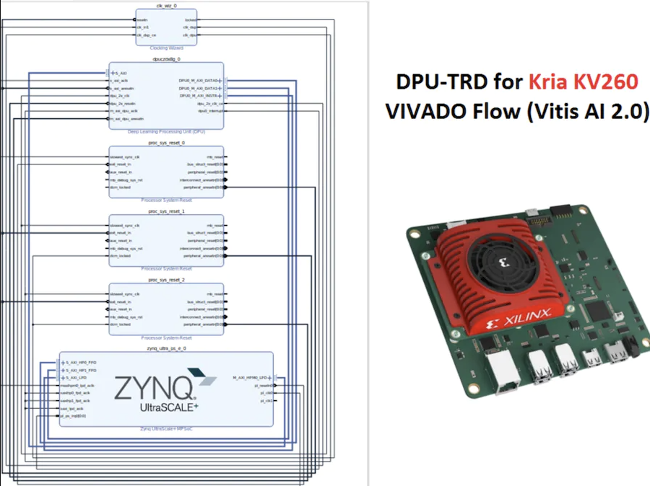
DPU
DPU = Deep Learning Processing Unit (Xilinx IP)
Tiny low-power accelerator running directly on FPGA
Customizable architecture for different AI workloads
Massive parallelism for:
conv layers
pooling
batch normalization
activation functions
Lower latency
Lower power consumption
Real-time performance on edge AI devices
20×–100× faster vs pure ARM CPU inference.
How it fits into PYNQ:
Integration with PYNQ Framework
Run AI inference using Python notebooks
No HDL or Vitis AI C++ coding required
Load a bitstream that includes the DPU
Use pre-built Python APIs to:
Load AI models (.xmodel format)
Feed input tensors
Receive inference outputs
[5]

Slide 12
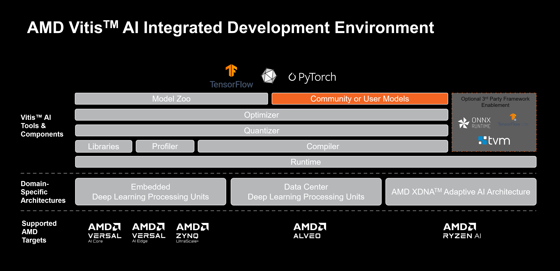
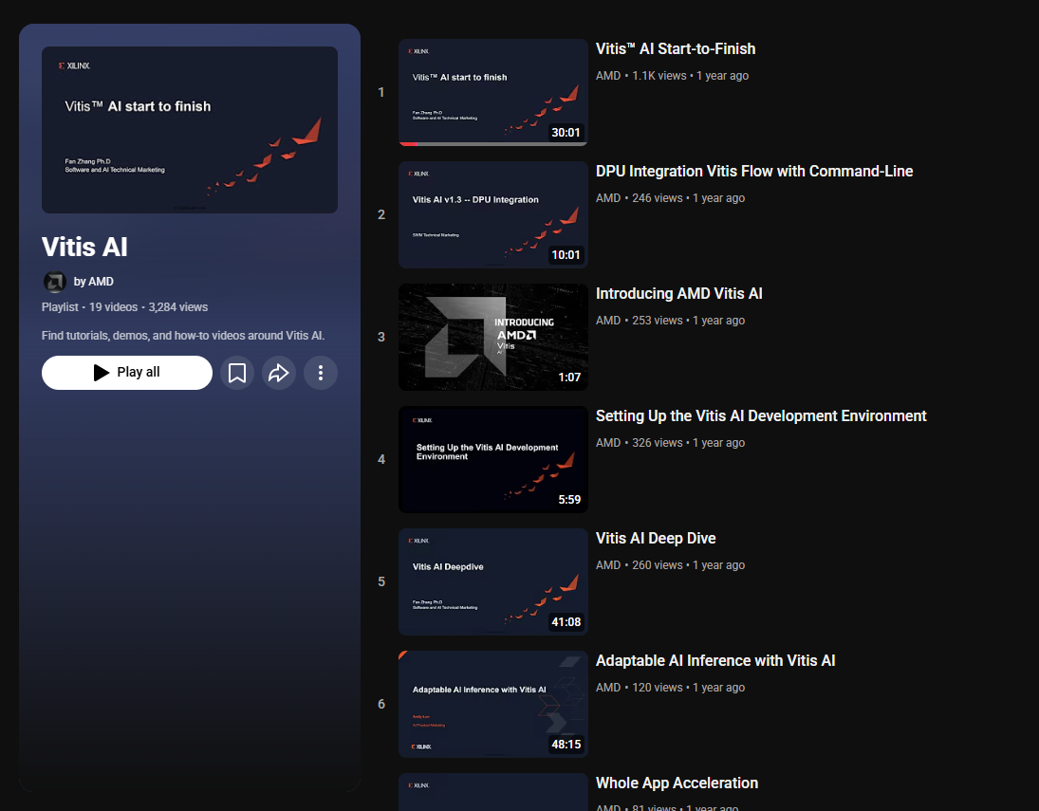
Vitis AI framework
Xilinx/Vitis-AI: Vitis AI is Xilinx’s development stack for AI inference on Xilinx hardware platforms, including both edge devices and Alveo cards.

Slide 13
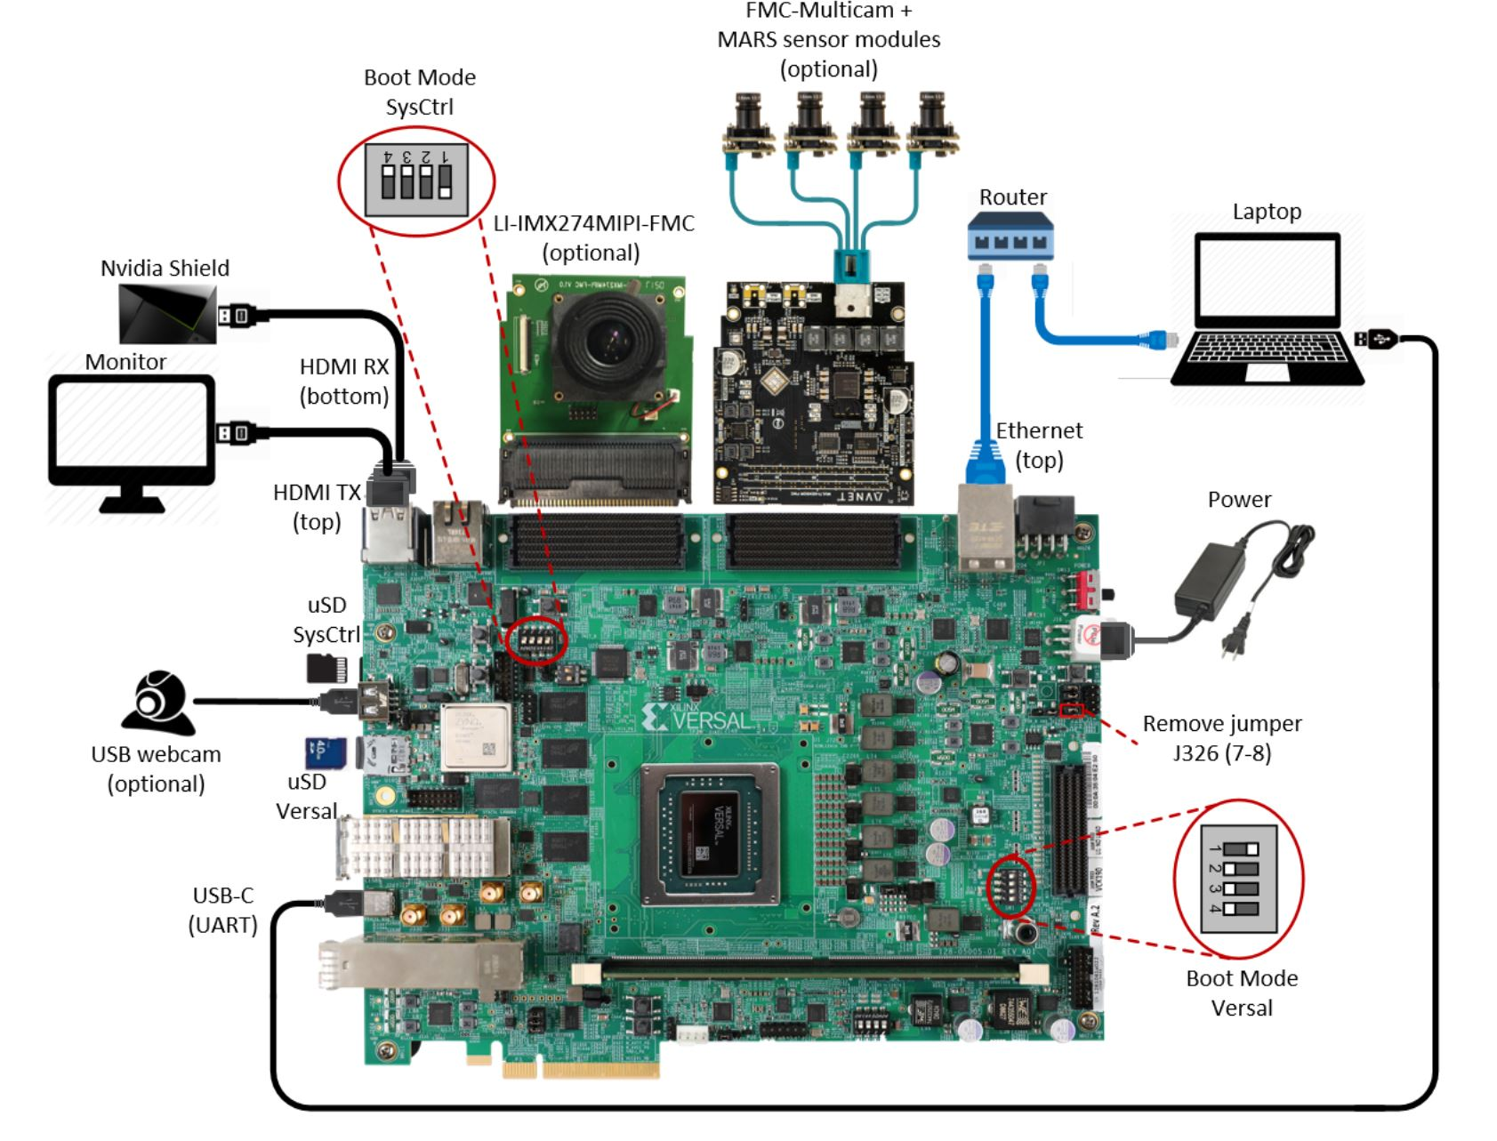
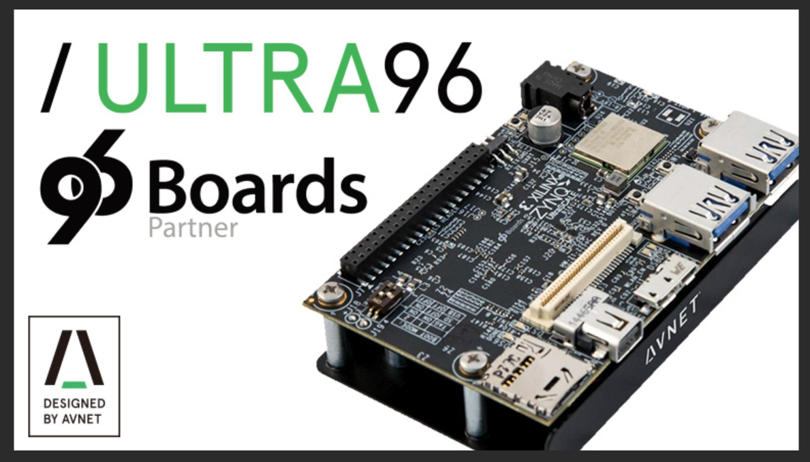
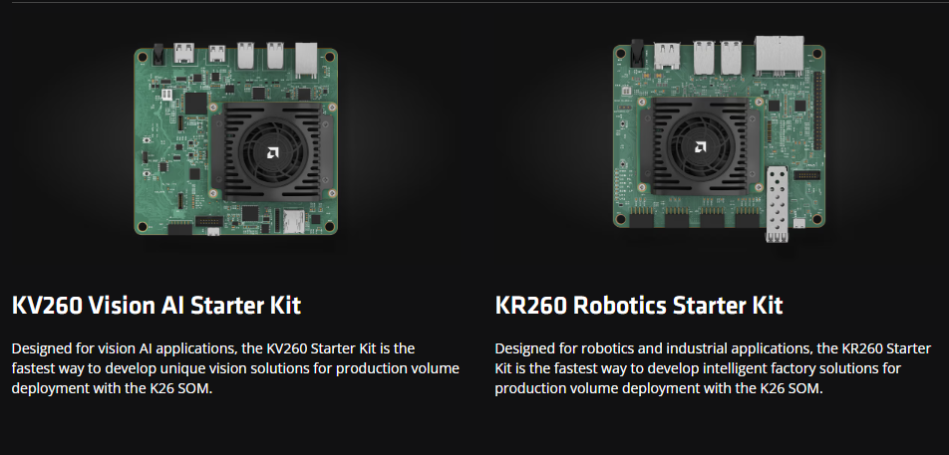
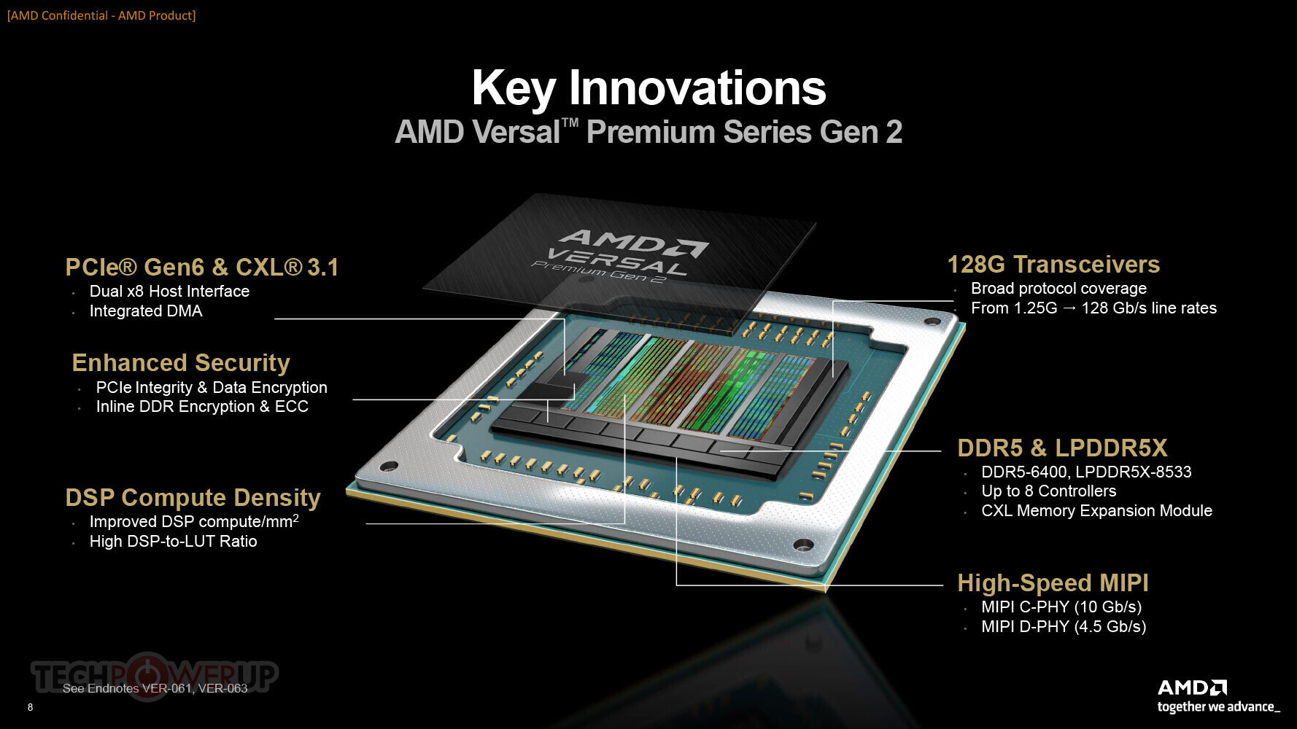
Recommended Families with Vitis AI
Chip: Zynq UltraScale+ ZU3EG
Category : Edge AI
Features: WiFi/BT

Slide 14
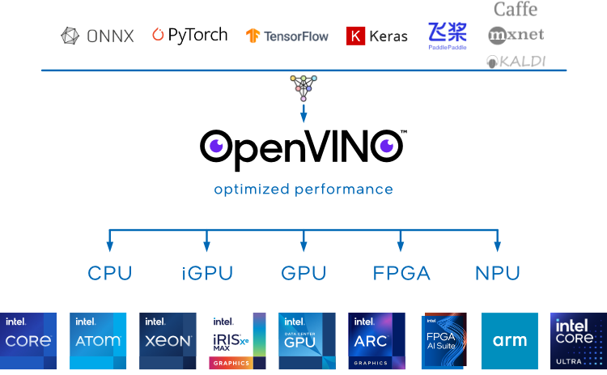
Intel OpenVINO framework
OpenVINO 2025.4 — OpenVINO™ documentation — Version(2025)

Slide 15
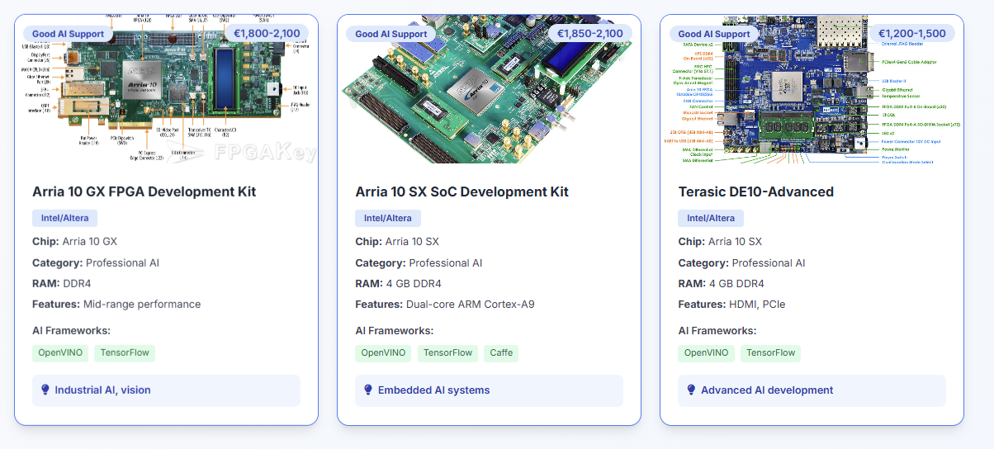
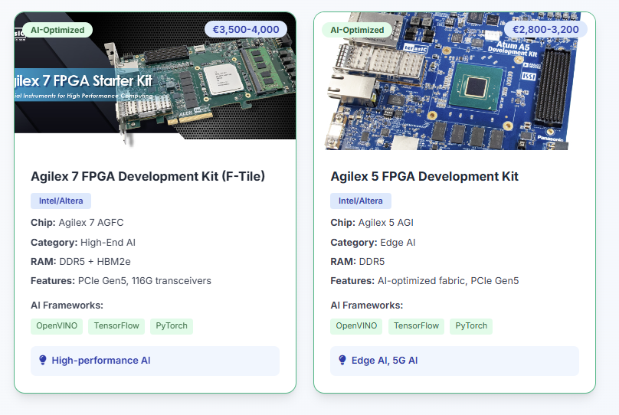
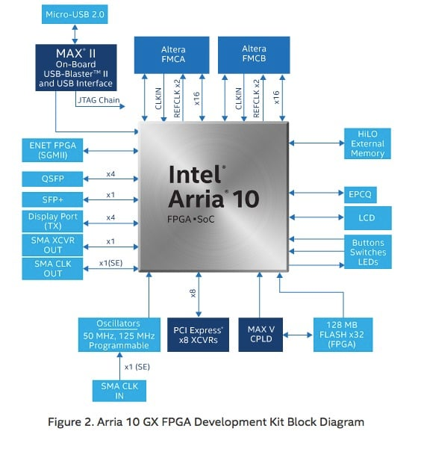
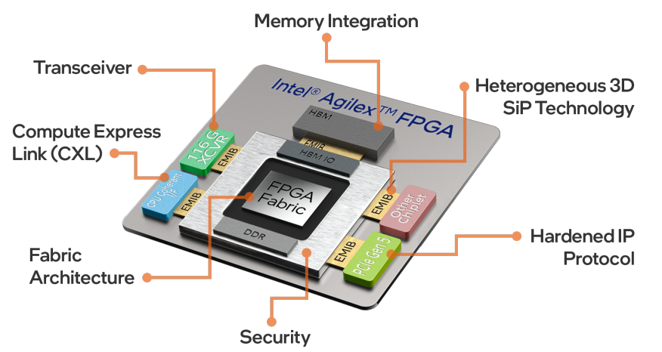
Recommended Families with OpenVINO

Slide 16
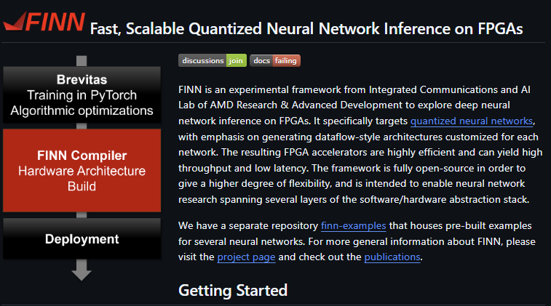
FINN Framework
Xilinx/finn: Dataflow compiler for QNN inference on FPGAs

Slide 17
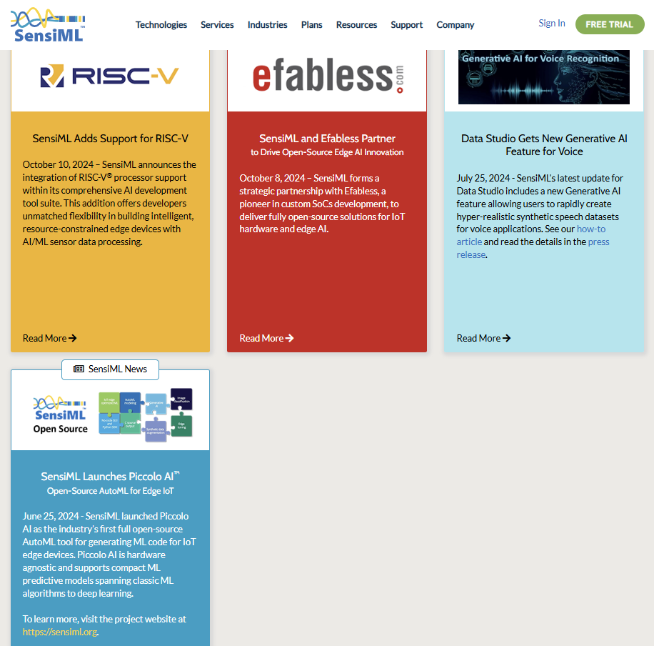
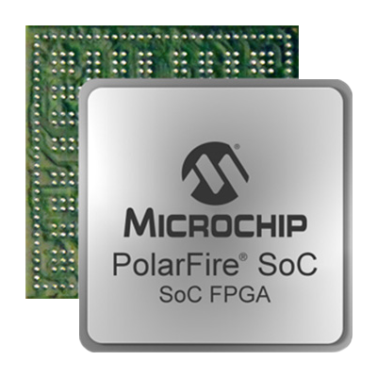
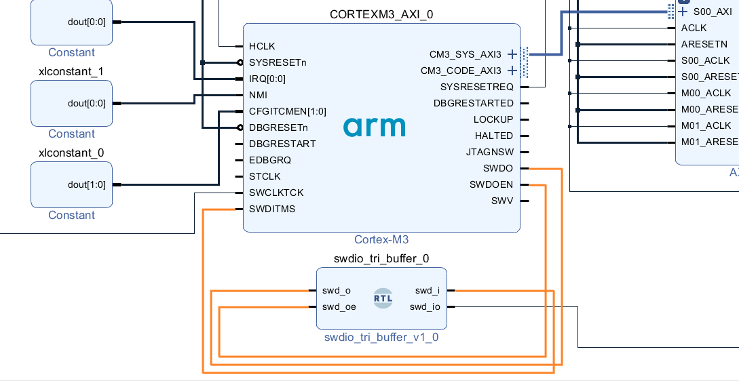
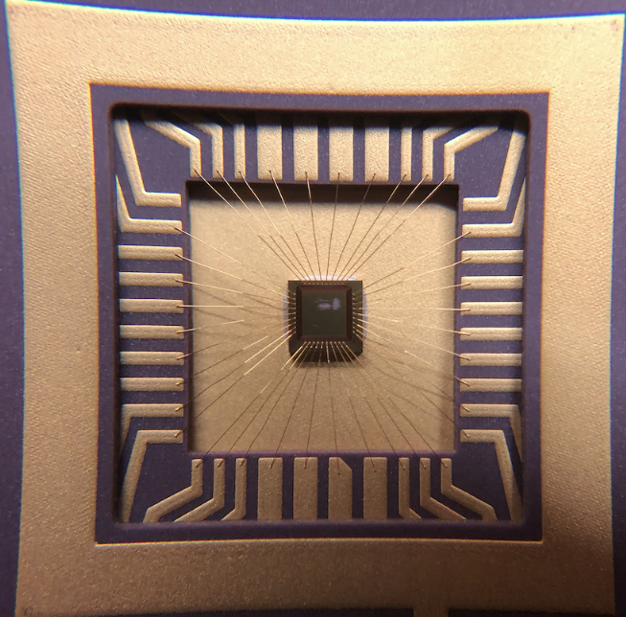
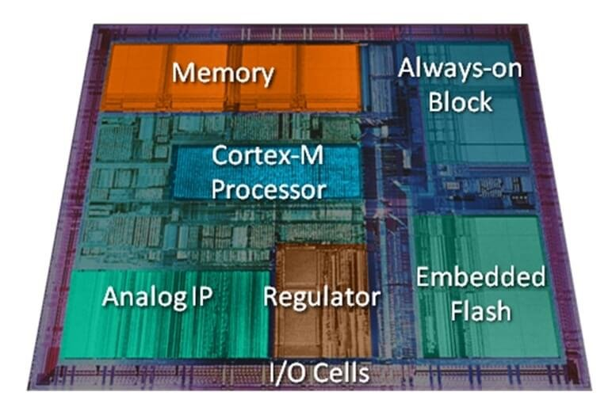
SensiML – Picolo AI OS framework
RISC-V processor cores (not ARM)
RISC-V-CPU Layout
Arm Cortex-M Processor

Slide 18
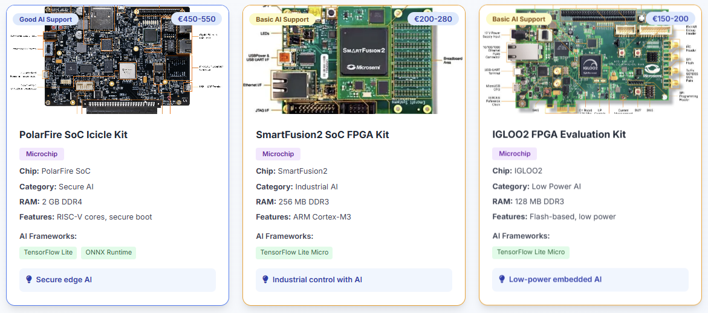
Recommended Families with Picolo AI

Slide 19
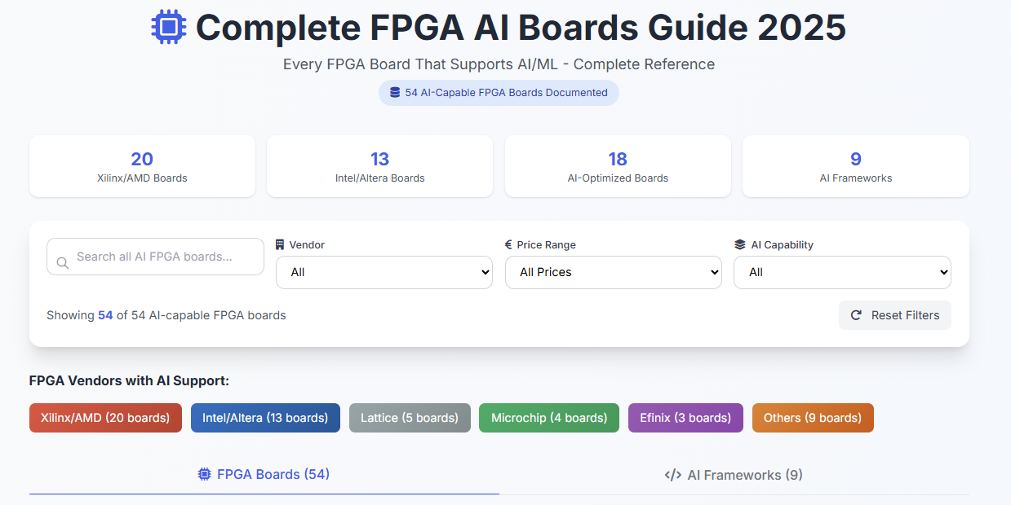
How to Get Started with FPGA AI?

Slide 20


Thank You
QUESTIONS & DISCUSSION
Let's build the future of FPGA-AI education together!

Slide 21
References
Xilinx/Vitis-AI: Vitis AI is Xilinx’s development stack for AI inference on Xilinx hardware platforms, including both edge devices and Alveo cards.
IEEE Xplore Full-Text PDF:
hls4ml - CMS Machine Learning Documentation
[4] PYNQ supported boards and PYNQ pre-built images | PYNQ
[5] DPU Configuration • DPUCZDX8G for Zynq UltraScale+ MPSoCs Product Guide (PG338) • Reader • AMD Technical Information Portal

